Slide 1


Thomas Sinmegn
December 8/2023

Slide 2

Outline
Executive Summary
Introduction
Methodology
Results
Conclusion
Appendix

Slide 3
Executive Summary
Summary of Methodologies
The research aims to predict if the Falcon 9 first stage will land successfully using machine learning algorithm. It also aims to determine which machine learning algorithms or models are more accurate in predicting the landing outcome. The data was downloaded from the Wikipedia page and it was re formatted, cleaned and transformed to make it suitable for further analysis. Exploratory data analysis was performed to understands fully the data set and finally predictive analysis was performed.
The research used four machine learning models to predict the landing outcome and compared the accuracy of each model. The machine learning models used in this research are logistic regression, support vector machine (SVM), decision tree and K-nearest neighbor(KNN).
Summary of all results
The landing success rate has been improved overtime
KSC LC-39A has the highest success rate among landing sites
All models performed similarly on the test set while the decision tree model has a higher accuracy rate.
Orbits ES-L1, GEO,HEO, and SSO have a 100% success rate

Slide 4
Introduction
Background and context
SpaceX advertises Falcon 9 rocket launches on its website, with a cost of 62 million dollars; other providers cost upward of 165 million dollars each, much of the savings is because SpaceX can reuse the first stage. Therefore if we can determine if the first stage will land, we can determine the cost of a launch. This information can be used if an alternate company wants to bid against SpaceX for a rocket launch. In this module, you will be provided with an overview of the problem and the tools you need to complete the course.
Problem statement
How payload mass, launch site, number flights, and orbits affect first stage landing success
Rate of successful landings overtime
Best predictive model for successful landing (binary classification)

Slide 5

Section 1

Slide 6
Methodology
Executive Summary
Data collection methodology:
The data was collected from the SapceX Rest API (api.spacexdata.com/v4/launches/past)
Perform data wrangling
Handling missing values
Dropping unnecessary columns
Creating outcome column
Perform exploratory data analysis (EDA) using visualization and SQL
Perform interactive visual analytics using Folium and Plotly Dash
Perform predictive analysis using classification models
The machine learning models used in this research are logistic regression, support vector machine (SVM), decision tree and K-nearest neighbor(KNN).

Slide 7
Data Collection
Using API
Steps
Request data from Spacex API(rocket launch data)
Decode response using .json() and convert to a dataframe using.json_normalize.
Request information about the launched from Spacex API using custom functions
Create dictionary from the data
Create dataframe from dictionary
Filter dataframe to contain only Falcon 9 launches
Replace missing values of Payload Mass
Web Scraping
Steps
Request data (Falcon 9 launch data) from Wikipedia
Create BeautifulSoup object from HTML response
Extract column names from HTML table header
Collect data from parsing HTML tables
Create dictionary from the data
Create dataframe from the dictionary

Slide 8
Data Collection – SpaceX API
Request API
Request data from SpaceX API
requests.get(Spacex url)
Get the data in JSON format
response=requests.get (static_json_url)
Data=pd.json_normalize(response)
Create a dataframe from the JSON file
Df=pd.DataFrame.from_dic(launch_dict)
Df_falcon9=Df[Df[‘boosterVersion’]!=‘Falcon_1’]
Response=response.json()
Using the steps in the previous slide the procedures of data collection codes
https://github.com/tsinmegn/Data-science-capstone-project/blob/main/jupyter-labs-spacex-data-collection-api.ipynb

Slide 9
Data Collection - Scraping
Request data (Falcon 9 launch data) from Wikipedia
Create BeautifulSoup object from HTML response
Extract column names from HTML table header
Collect data from parsing HTML tables
Create dictionary from the data
Create dataframe from the dictionary
Steps
Request data (Falcon 9 launch data) from Wikipedia
Create BeautifulSoup object from HTML response
Extract column names from HTML table header
Collect data from parsing HTML tables
Create dictionary from the data
Create dataframe from the dictionary
https://github.com/tsinmegn/Data-science-capstone-project/blob/main/jupyter-labs-spacex-data-collection-api.ipynb

Slide 10
Data Wrangling
The first step in any data analysis starts with understanding the data and checking the data quality for completeness, consistency and accuracy through exploratory Data Analysis(EDA).
EDA involves checking for missing values, identifying the data type for each variable, creating new features, re-naming, deleting or adding columns and rows etc.
https://github.com/tsinmegn/Data-science-capstone-project

Slide 11
EDA with Data Visualization
Scatter plots, line charts and bar charts were plotted to explore the data.
Scatter plots were used to explore the relation ship between two continuous variables. For example we used scatter plot to see how the FlightNumber and Payload variables would affect the launch outcome.
Bar plots are used to explore the relationship between categorical variables. Bar plots are used to visualize the relationship between launch success rate and orbit type.
Line charts are used to visualize the variables through time. For example success rates over the years is visualized using the line chart.
https://github.com/tsinmegn/Data-science-capstone-project

Slide 12
EDA with SQL
The queries used to solve tasks:
Display the names of unique launch sites in the space (%sql select DISTINCT Launch_Site FROM SPACEXTABLE;)
Display 5 records where launch sites begin with the string’CCA’(%sql select Launch_Site from SPACEXTABLE WHERE Launch_Site like 'CCA%' limit 5;)
Display the total payload mass carried by boosters launched by NASA(CRS) (%sql select sum (PAYLOAD_MASS__KG_) from SPACEXTABLE where CUSTOMER = 'NASA (CRS)’)
Display Average payload mass carried by booster version F9 v1.1(%sql select AVG(PAYLOAD_MASS__KG_) from SPACEXTABLE where BOOSTER_VERSION = 'F9 v1.1’)
List the date when the first succesful landing outcome in ground pad was achieved(%sql select Min(Date) from SPACEXTABLE where Landing_Outcome like 'Success%’)
List the names of the boosters which have success in drone ship and have payload mass greater than 4000 but less than 6000(%sql select BOOSTER_VERSION from SPACEXTBL where Landing_Outcome = 'Success (drone ship)' and PAYLOAD_MASS__KG_ > 4000 and PAYLOAD_MASS__KG_ < 6000)
https://github.com/tsinmegn/Data-science-capstone-project

Slide 13
Build an Interactive Map with Folium
Markers indicating launch sites
Added blue circle at NASA Johnson Space Center’s coordinate with a popup label showing its name using its latitude and longitude coordinates
Added red circles at all launch sites coordinates with a popup label showing its name
Colored markers of Launch Outcomes
Added colored markers of successful and unsuccessful launches at each launch site to show which launch site have higher success rates.
Distance between a launch site to proximities
Added colored lines to show distance between launch site CCAFS SLC-40 and its proximity to the nearest coastline,railway, highway, and city.
Github link to the Notebook
https://github.com/tsinmegn/Data-science-capstone-project

Slide 14
Build a Dashboard with Plotly Dash
Dropdown list with launch sites
Allow selection of launch sites or a specific launch site
Pie chart showing successful launches
Allow user to see successful and unsuccessful launches as a percent of the total
Slider of Payload Mass Range
Allow user to select payload mass range
Scatter chart showing payload mass vs success rate by Booster version.
Allow user to see the correlation between Payload and Launch Success

Slide 15
Predictive Analysis (Classification)
Import the required libraries
Acquire the data set
Data preprocessing( EDA and visualization, One Hot Encoding to convert categorical variables to binary variables)
Splitting the data into training data and test data
Apply the machine learning model to the training data( Logistic Regression, KNN, Decision Trees, Support vector machines)
Evaluate the accuracy of the models using (Accuracy Score, Jaccard Index, F1-Score ,LogLoss,R2-Score)
Compare which models predict the success of landing. In our case Decision tree model has a slightly higher accuracy rate.
Summarize how you built, evaluated, improved, and found the best performing classification model
You need present your model development process using key phrases and flowchart
Add the GitHub URL of your completed predictive analysis lab, as an external reference and peer-review purpose

Slide 16
Results
Exploratory data analysis results
Interactive analytics demo in screenshots
Predictive analysis results

Slide 17

Section 2

Slide 18
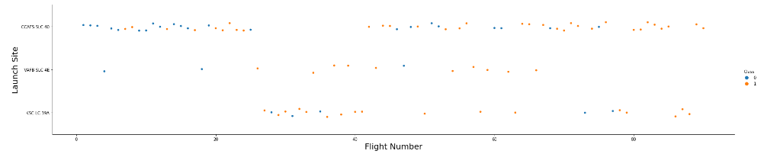
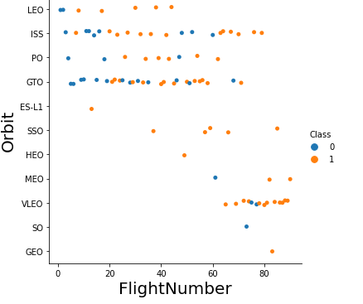
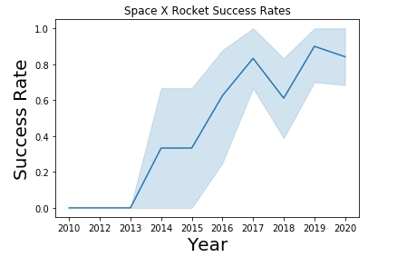
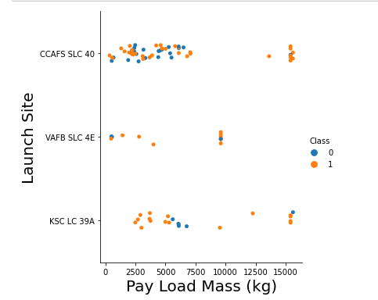
Flight Number vs. Launch Site
A scatter plot of Flight Number vs. Launch Site
A scatter plot of Orbit type with payload mass
LEO orbit the Success appears related to the number of flights; on the other hand, there seems to be no relationship between flight number when in GTO orbit.
With heavy payloads the successful landing or positive landing rate are more for Polar, LEO and ISS.
The success rate since 2013 kept increasing till 2020

Slide 19
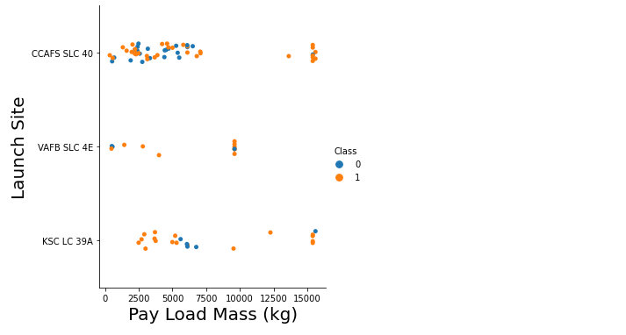
Payload vs. Launch Site
Payload Vs Launch Site scatter plot
VAFB-SLC launch site there are no rockets launched for heavy payload mass (greater than 10000).

Slide 20
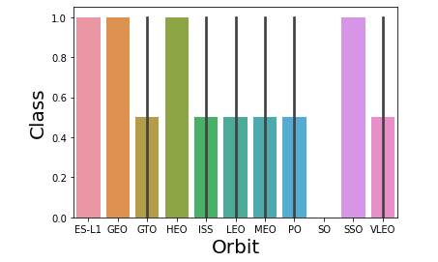
Success Rate vs. Orbit Type
ES-L1, GEO,HEO and SSO have higher success rate

Slide 21
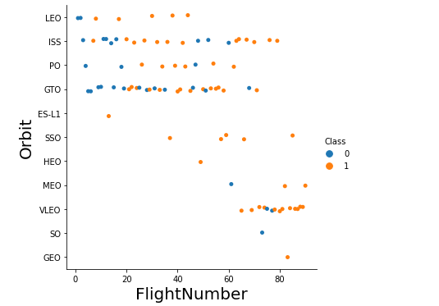
Flight Number vs. Orbit Type
The LEO orbit the Success appears related to the number of flights; on the other hand, there seems to be no relationship between flight number when in GTO orbit.

Slide 22
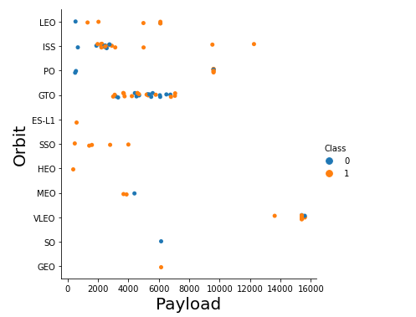
Payload vs. Orbit Type
With heavy payloads the successful landing or positive landing rate are more for Polar, LEO and ISS.
However for GTO we cannot distinguish this well as both positive landing rate and negative landing(unsuccessful mission) are both there here.

Slide 23
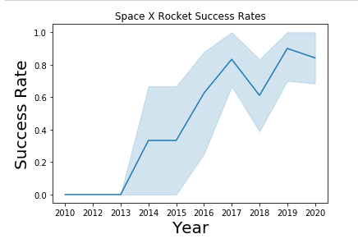
Launch Success Yearly Trend
Success rate since 2013 kept increasing till 2020

Slide 24
All Launch Site Names
The names of the unique launch sites
CCAFS LC-40
VAFB SLC-4E
KSC LC-39A
CCAFS SLC-40

Slide 25
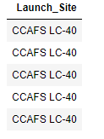
Launch Site Names Begin with 'CCA'
5 records where launch sites begin with `CCA`

Slide 26
Total Payload Mass
The total payload carried by boosters from NASA is 45596 Kg.
Present your query result with a short explanation here

Slide 27
Average Payload Mass by F9 v1.1
The average payload mass carried by booster version F9 v1.1is 2928.4Kg

Slide 28
First Successful Ground Landing Date
The first successful landing outcome on ground pad had taken place on 2015-12-22

Slide 29
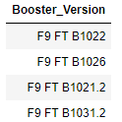
Successful Drone Ship Landing with Payload between 4000 and 6000
Names of boosters which have successfully landed on drone ship and had payload mass greater than 4000 but less than 6000

Slide 30
Total Number of Successful and Failure Mission Outcomes
The total number of successful and failure mission outcomes are 98

Slide 31
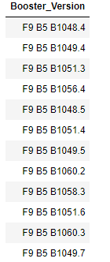
Boosters Carried Maximum Payload
Booster which have carried the maximum payload mass

Slide 32
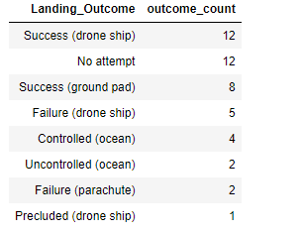
Rank Landing Outcomes Between 2010-06-04 and 2017-03-20
Ranking the count of landing outcomes (such as Failure (drone ship) or Success (ground pad)) between the date 2010-06-04 and 2017-03-20, in descending order

Slide 33

Section 3

Slide 34
<Folium Map Screenshot 1>
Replace <Folium map screenshot 1> title with an appropriate title
Explore the generated folium map and make a proper screenshot to include all launch sites’ location markers on a global map
Explain the important elements and findings on the screenshot

Slide 35
<Folium Map Screenshot 2>
Replace <Folium map screenshot 2> title with an appropriate title
Explore the folium map and make a proper screenshot to show the color-labeled launch outcomes on the map
Explain the important elements and findings on the screenshot

Slide 36
<Folium Map Screenshot 3>
Replace <Folium map screenshot 3> title with an appropriate title
Explore the generated folium map and show the screenshot of a selected launch site to its proximities such as railway, highway, coastline, with distance calculated and displayed
Explain the important elements and findings on the screenshot

Slide 37

Section 4

Slide 38

Launch Success Dashboard
The launch site KSC LC-39A had the most successful launches, with 41.7% of the total successful launches.

Slide 39
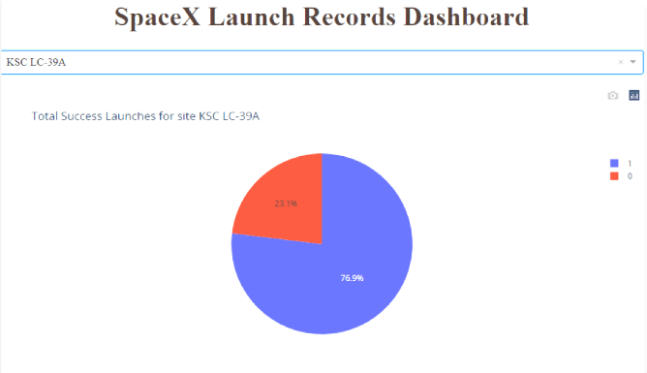
The launch site with the highest launch success rate
The launch site KSC LC-39A also had the highest rate of successful launches, with a 76.9% success rate.

Slide 40
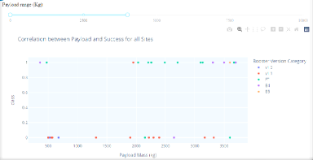
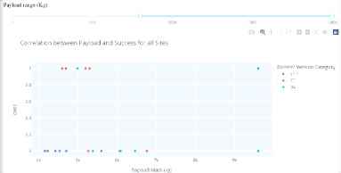
Launch Outcome vs. Payload Scatter Plot for all sites

Slide 41

Section 5

Slide 42
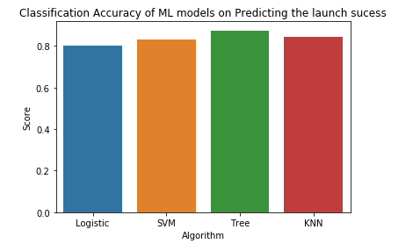
Classification Accuracy
Decision tree classification model has the highest classification accuracy

Slide 43
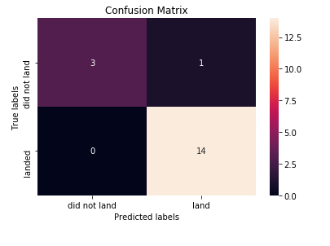
Confusion Matrix
Decision tree confusion matrix on predicting launch success
As can be seen from the confusion matrix only one observation is classified wrongly by the model.

Slide 44
Conclusions
The best performing model for predicting the launch success in Decision tree with the highest accuracy prediction rate.

Slide 45
Appendix
Include any relevant assets like Python code snippets, SQL queries, charts, Notebook outputs, or data sets that you may have created during this project

Slide 46


